Slide 1
Predictive Modeling on Digital Asset Return
Trading Signal & Temporal Structure of Bitcoin
Team: Donglan Dai, Yannan Cao, Xingchen Li,
Yihan Luo, Ruimin Ma
Instructor: Prof. David Juran

Slide 2
01
Introduction
What managerial problem are we solving?

Slide 3
$1,240,000,000,000
Market Cap of Bitcoin

Slide 4
Institutional Digital Asset Investment Landscape
How to build profitable
Investment strategies?
Investors And Funds
Indices for Digital Asset I.e. FTSE Grayscale, Bloomberg Galaxy
Digital Asset Research (DAR)
Centralized Exchanges I.e. Coinbase, Binance
Data Providers
Trading Platform
Investment Decision

Slide 5
—Abigail Johnson, CEO of Fidelity Investments
“"We believe that blockchain technology has the potential to fundamentally change market structures."”

Slide 6
Why ETF?
Let’s Build a Strategy.
Our goal: Build an active investment strategy by predicting daily return, which will support future portfolio management.

Slide 7
Presentation Overview
EDA
Feature Engineering
Robust Modeling
Data is the fuel. EDA tells the story.
Clean the data.
Build the signals.
Iteratively build models that predict returns.

Slide 8
02
Exploratory Data Analysis
Understand Structure of Data and Potential Patterns

Slide 9
EDA Main Components
Descriptive Statistics
Time Series Analysis
Volatility Analysis
Correlation Analysis

Slide 10
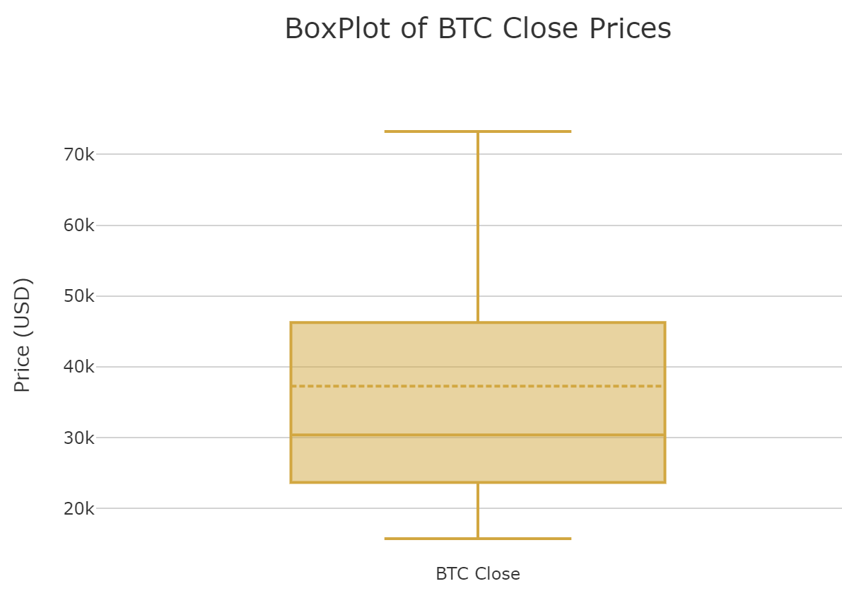
Boxplot Visualization
Bitcoin as a high risk, high reward asset compared to more stable investments
 | Gold Close $ | SPY Close $ | Rate Close % | VIX Close $ | BTC Close $
MIN | 1633.4 | 524 | 1.64 | 11.86 | 15.76k
MAX | 2610.7 | 847 | 4.99 | 38.57 | 73.22k
MEDIAN | 1959.7 | 641 | 3.8 | 18.41 | 30.44k
1st Q | 1845.5 | 589.67 | 3.34 | 14.18 | 23.70k
3rd Q | 2069 | 740.85 | 4.22 | 23.43 | 46.25k
Notes:
Comparing the quartiles of each price, it can be found that the fluctuation range of High is larger than that of Low and Close, indicating that Bitcoin is most volatile at extreme market prices (highest prices), and investors may have more selling or buying behaviors at high prices.
Low and Close have relatively small fluctuations, indicating that the market is relatively more stable at low prices and the market adjustment is more moderate.

Slide 11
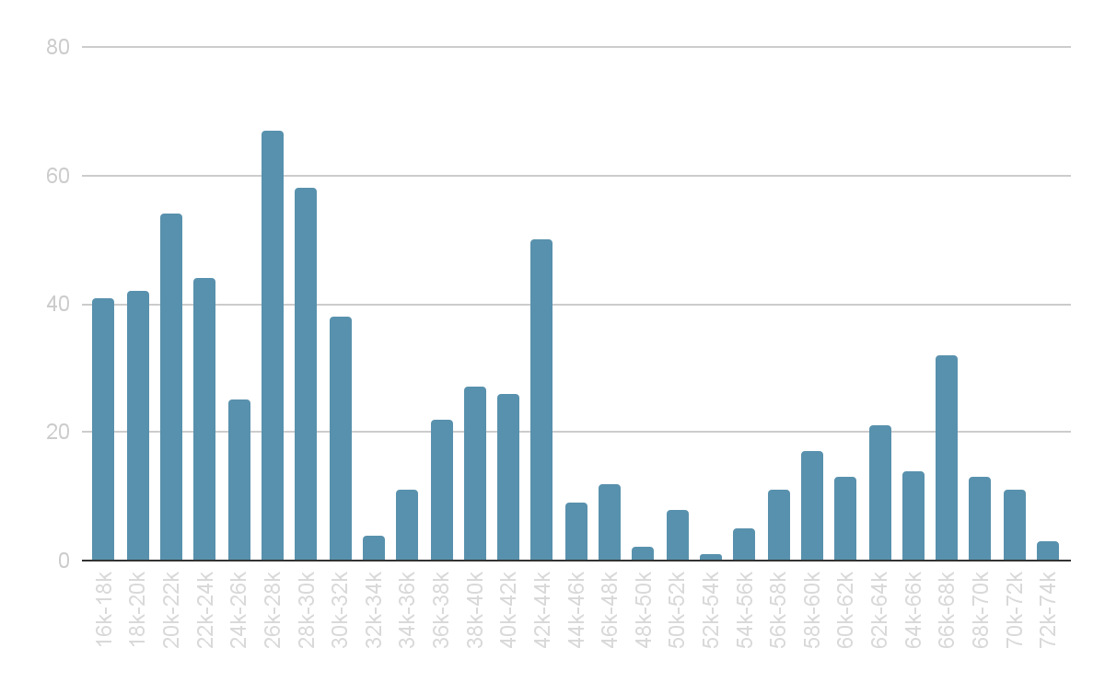
Distribution Visualization
Bitcoin fluctuates drastically between different price ranges.
Histogram of Bitcoin Close Price
Multiple clusters:
$20k, $30k, $40k, and $60k
26k-28k highest frequency
Potential resistance or support

Slide 12
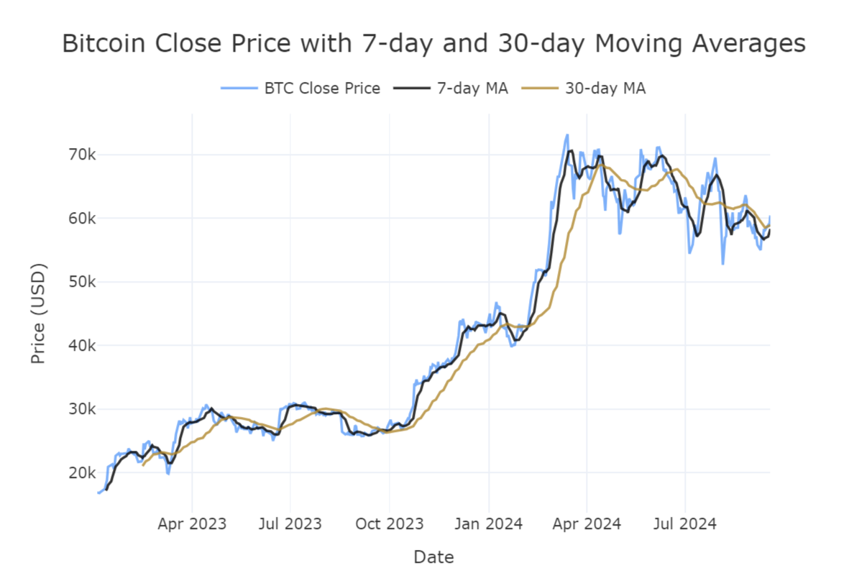
Bitcoin Close Price
with 7-day and 30-day Moving Averages
Trend judgment：
When 7-day moving average is above the 30-day moving average, the market usually exhibits an upward trend, vice versa.
The 7-day reacts faster to price changes, while the 30-day moving average is smoother.

Slide 13
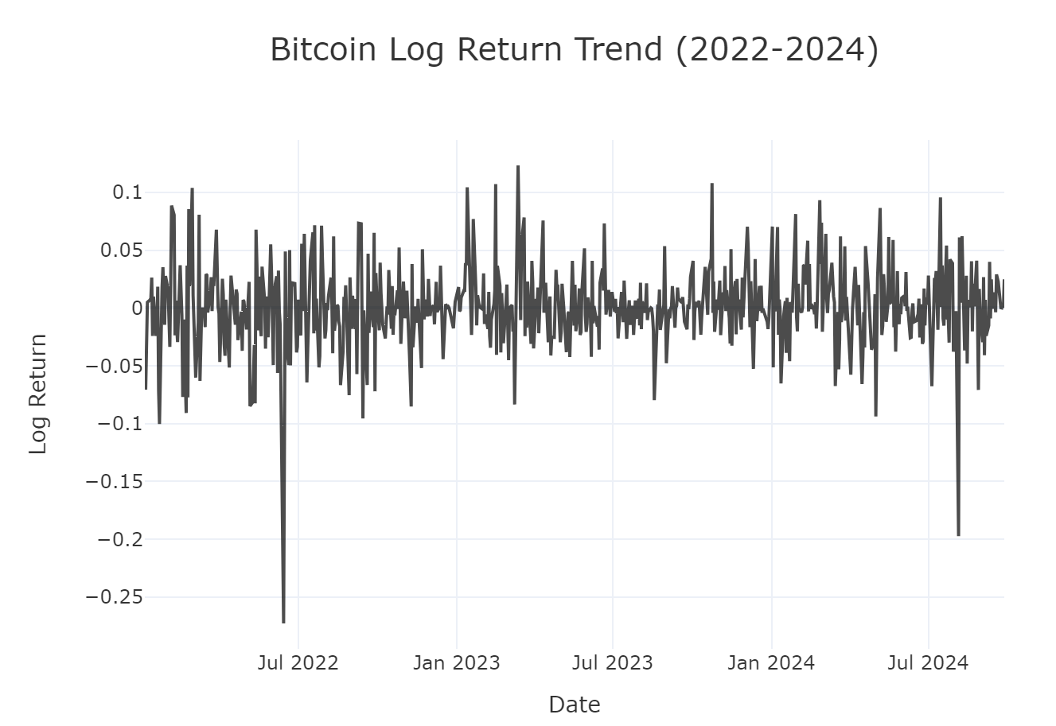
Bitcoin Log Return Trend
Studying log returns helps in smoothing out large variances, giving a clearer picture of the asset's volatility and performance from 2022 to 2024.
Log return: the natural logarithm of the ratio between the current day's closing price and the previous day's closing price, a widely used metric in financial analysis
The trend reflects both consistent smaller movements and occasional large deviations, suggesting a market that is typically stable but prone to abrupt changes in return.

Slide 14
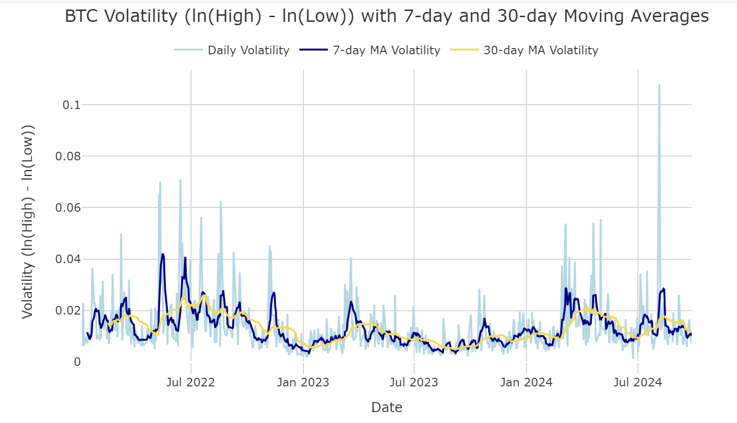
Understand the Asset’s Volatility Over Time
Moving averages smooth short-term fluctuations, highlighting periods of high or low volatility.
Shows the daily volatility of Bitcoin
log difference between high and low prices (ln(High) - ln(Low))
Captures short-term and long-term trends in Bitcoin's price fluctuations

Slide 15
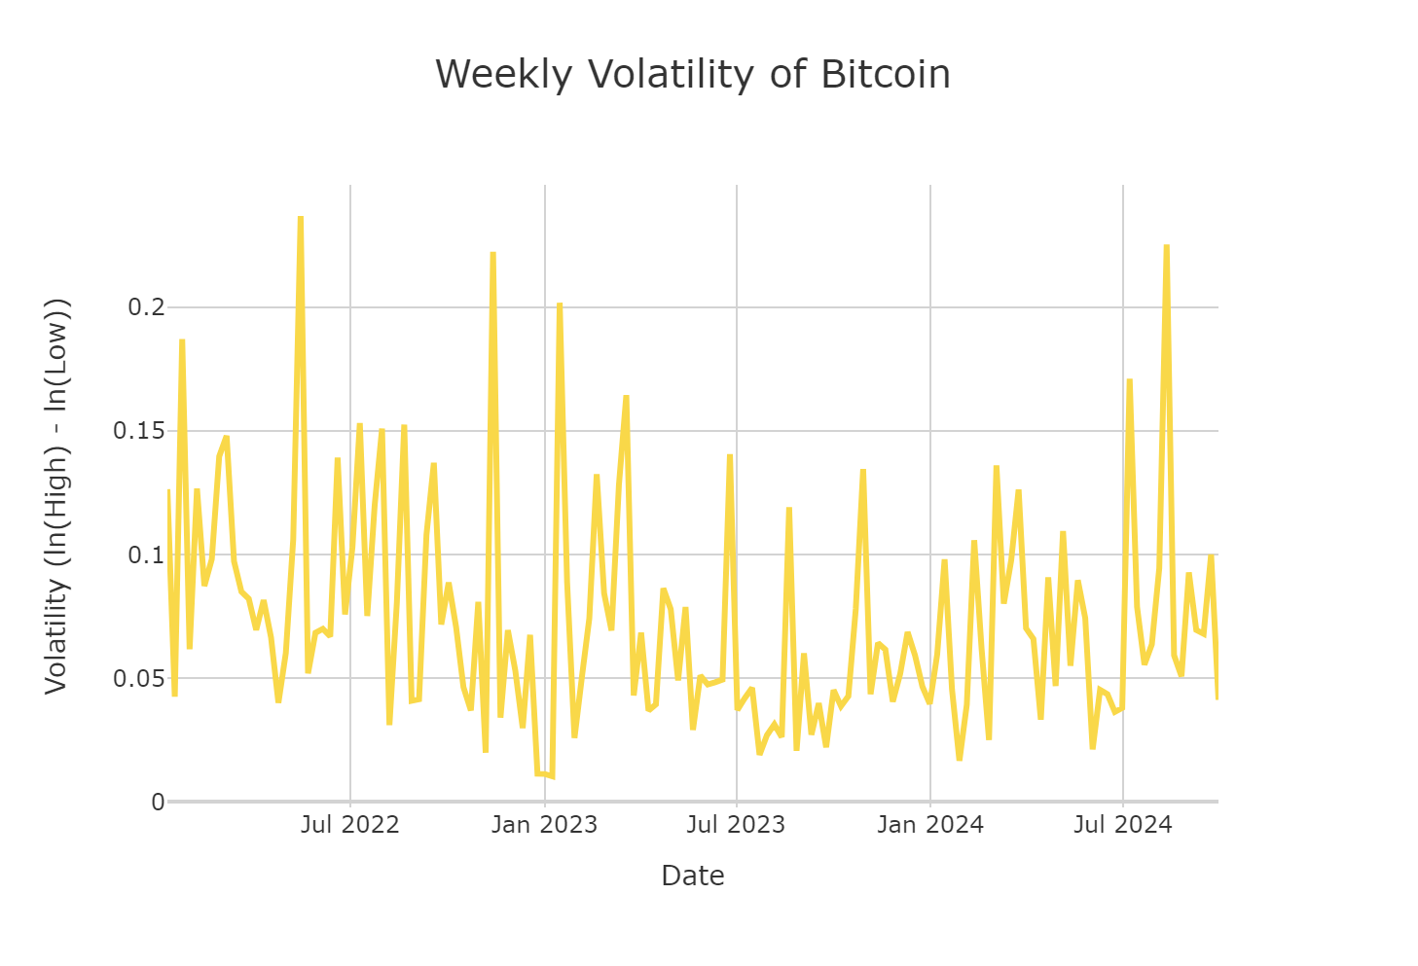
Understand the Asset’s Volatility Over Time
Aggregate the Daily Data to a Weekly Basis and Visualize the Volatility Trend
Mid to Late 2022: higher volatility with sharp peaks, suggesting significant market events or instability
Early 2023: relatively lower volatility, indicating a more stable phase
Mid 2023 to Early 2024: Several spikes, more turbulent weeks for Bitcoin during this time

Slide 16
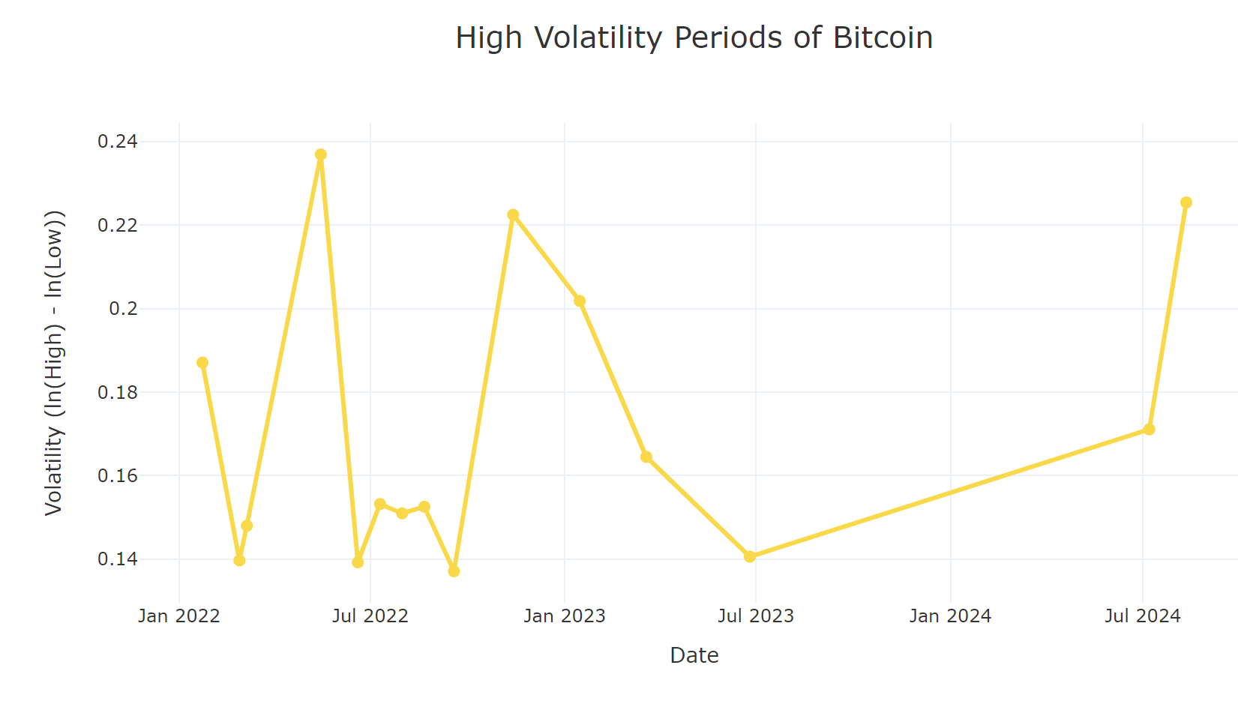
Recognize High-Volatility Periods
Identify Periods of High Volatility by Focusing on the Top 10% of the Weekly Volatility Values
volatility spikes are distributed unevenly over time, with significant peaks around early 2022, late 2022
Anti-Money Laundering (AML）
The Collapse of FTX

Slide 17
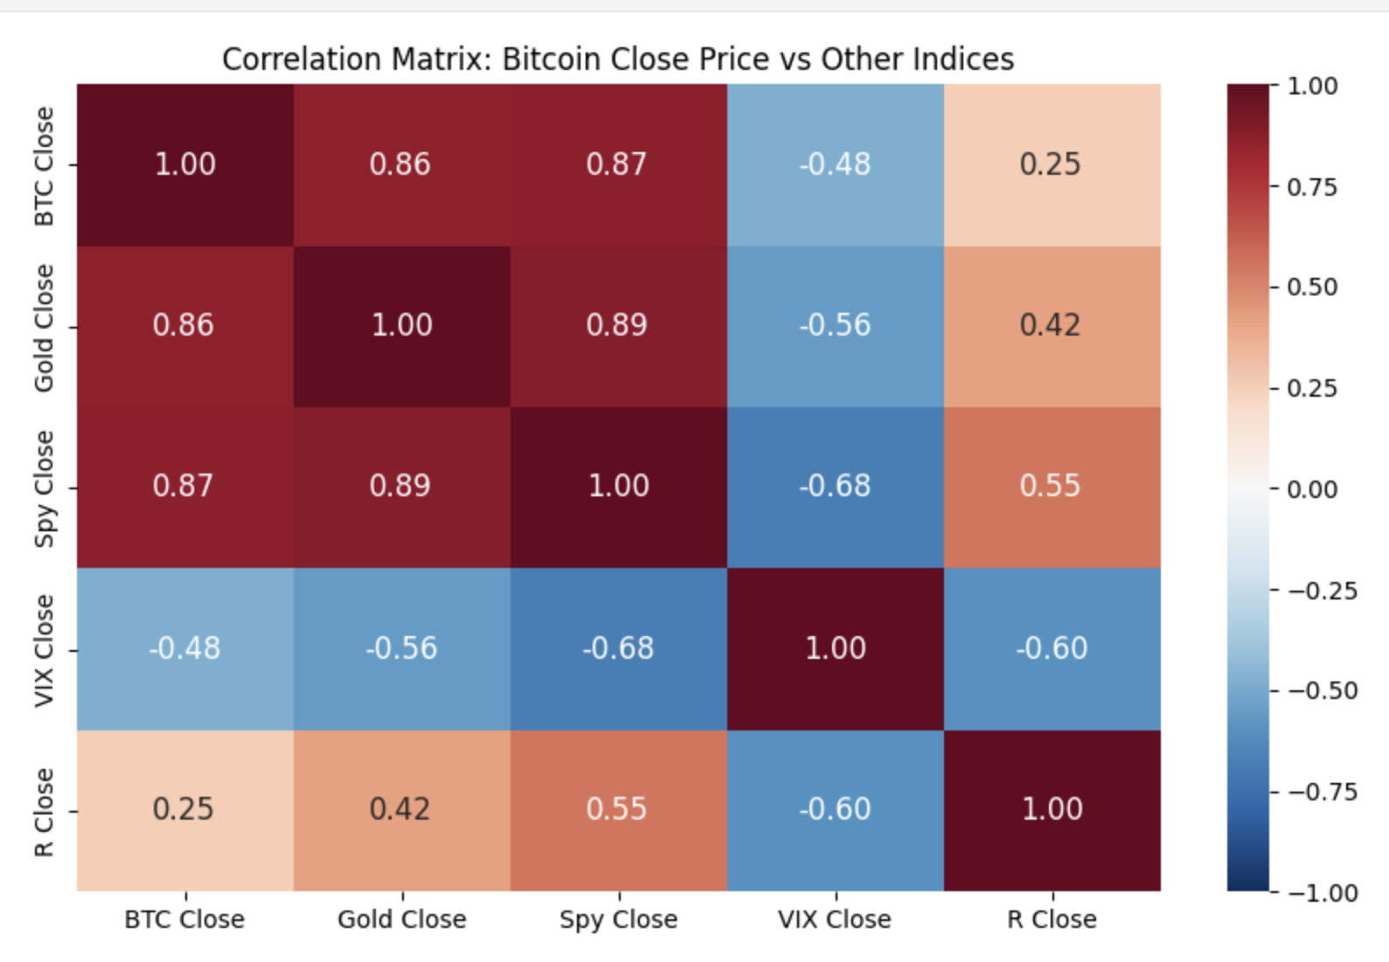
Correlation Matrix of Bitcoin Close Price
vs. Other Indices' Close Price
Visualization of How Bitcoin's Price Movements Relate to Other Assets, Offering Insights into Asset Co-movements
BTC & Gold: 0.86
BTC & SPY: 0.87
BTC & VIX: -0.48
Notes:
The purpose of this analysis is to understand how Bitcoin’s price movements co-relate with other key assets such as Gold, SPY (S&P 500), and VIX. This gives us insights into how Bitcoin price trend aligns with or diverges from traditional financial markets.
BTC & SPY (0.87): Bitcoin's strong correlation with SPY reflects its alignment with broader market trends, showing that its price often moves in tandem with stock markets.
BTC & VIX (-0.48): There’s a moderate negative correlation with the VIX (Volatility Index), indicating that Bitcoin price tends to decline when market volatility increases, possibly due to its risk-on nature.
These correlations will partly influence how we select input variables for our time-series modeling and regression analysis at a later stage.

Slide 18
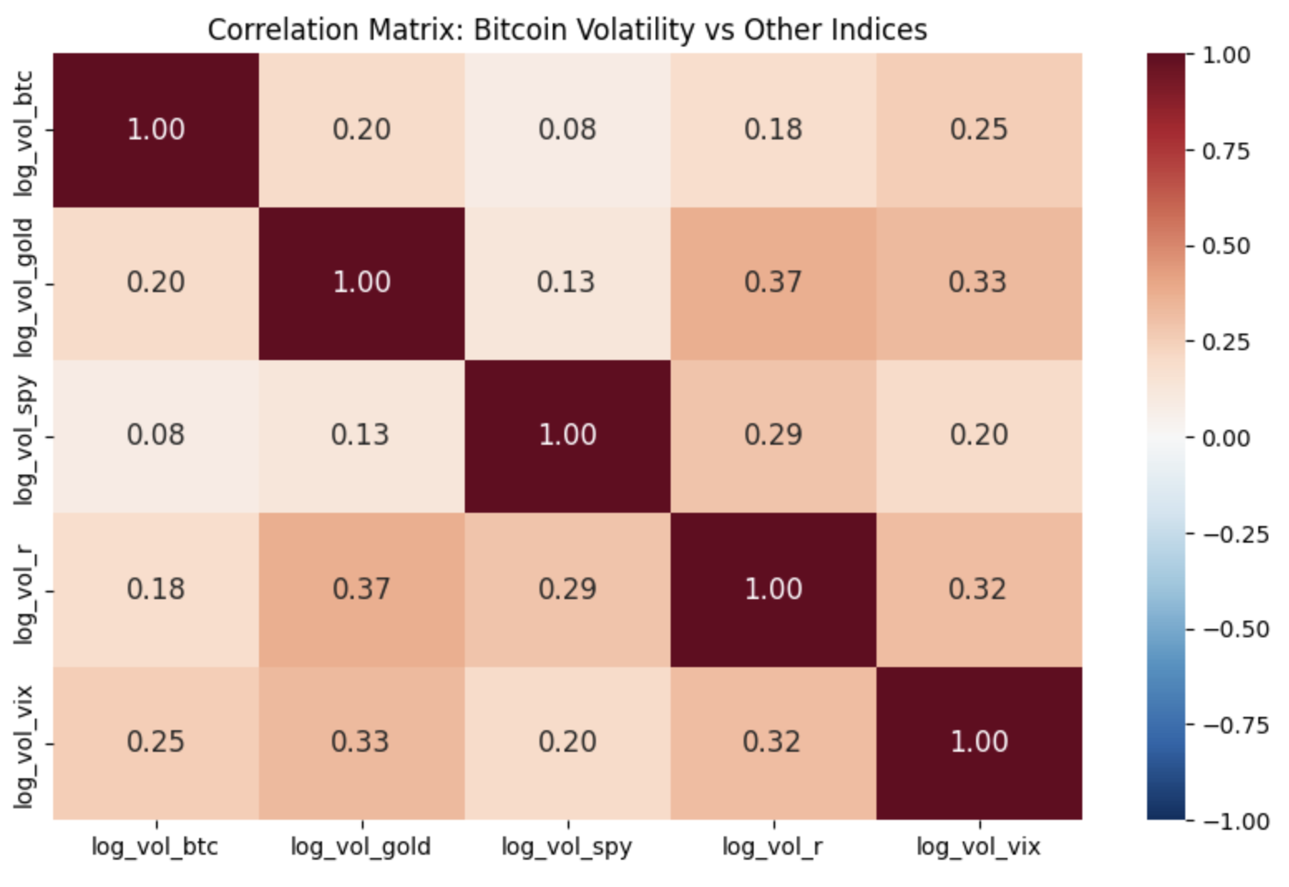
Correlation Matrix of Bitcoin Volatility
vs. Other Indices' Volatility
Highest：0.25
volatility movements are generally not strongly related
Notes:
The second matrix focuses on the volatility correlations. Volatility correlations can provide insights into whether these assets experience synchronized spikes in volatility.
Highest Correlation (0.25): The correlations are generally weak, indicating that Bitcoin's volatility is relatively independent of the volatility seen in traditional assets such as Gold or SPY.

Slide 19
Lagged Effect Analysis
Determine How Much Influence of Self Past Values (up to 30 days) Have on Current Values
Partial Autocorrelation Function (PACF)
Measure Correlation
Provide Insights
Analysis to Perform
Measures the direct correlation between time series values and their lagged values, excluding the effects of intermediate lags
Help determine how far into the past we need to look when analyzing Bitcoin’s volatility and price movements
Bitcoin Volatility
Bitcoin Closing Price
Bitcoin Log Return
Notes:
For lagged analysis, the question we're really trying to answer here is how much influence self-past values have on current values. Take the Bitcoin price or volatility today, to what extent does it impact the price or volatility tomorrow, the day after tomorrow, or 30 days after? We're trying to use lag analysis to determine the most relevant time frame where the lag impact takes place. And the proxy we're using is called PACF, partial autocorrelation function. It is a measure of correlation specifically designed for time series, focuses on how much influence past values have on current value, and it's called partial because it isolates a direct relationship between time lag variables. Filtering out intermediate correlations so we can observe the direct impact.

Slide 20
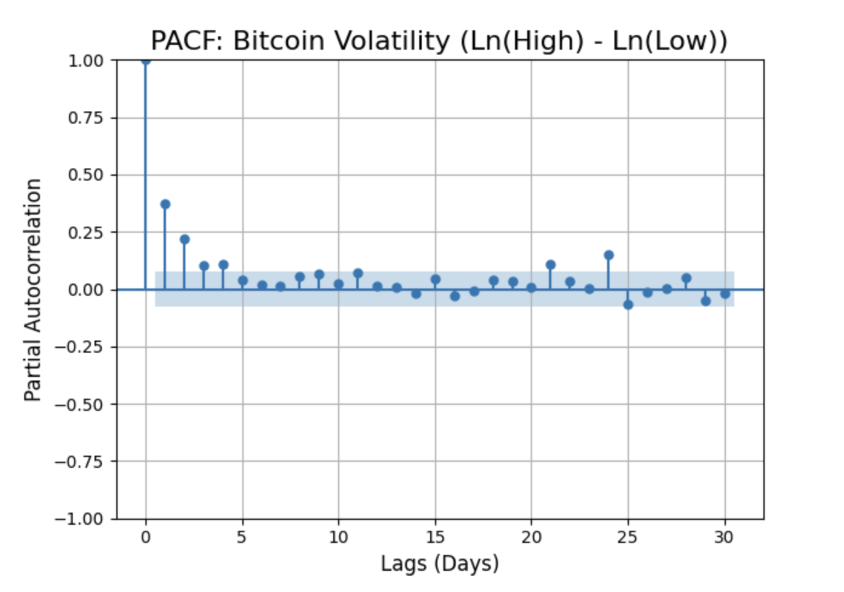
PACF: Bitcoin Volatility
Insights
Assess how past volatilities influence future volatilities
Significant Lag Effects: a notable spike at lag 1, indicating that the previous day's volatility has a relatively strong direct influence on the current day's volatility
Diminishing Impact: As the lag increases, the partial autocorrelations generally decrease and fluctuate around zero
Notes:
A statistically significant spike at Lag 1, 2, 3, 4, 21, 24 with 1 being the most notable. This shows that yesterday’s volatility strongly influences today’s volatility.

Slide 21
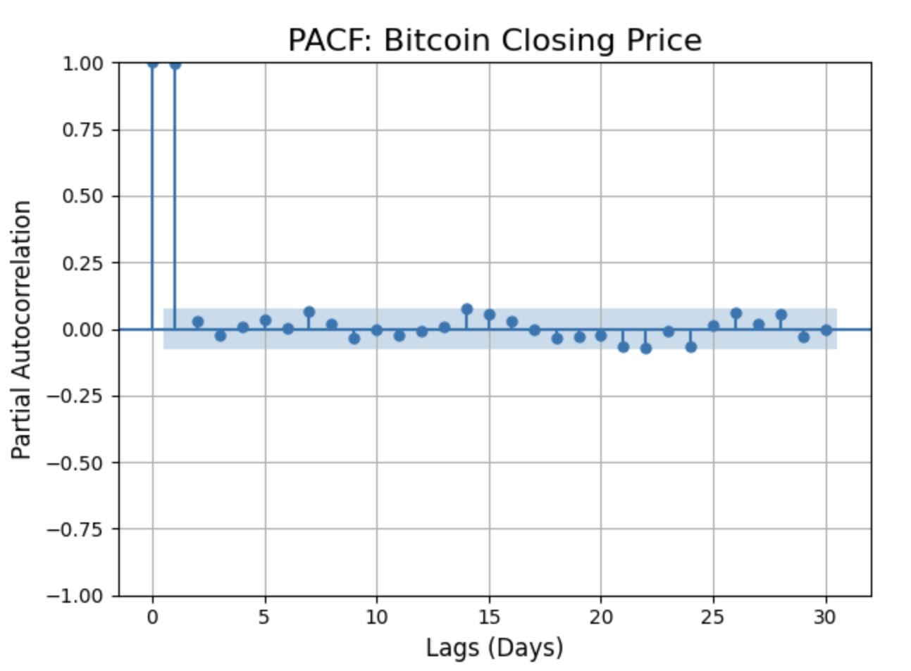
PACF: BTC Close Price
Insights
Evaluate the Lag Effect of Past Closing Prices on Future Prices
A strong short-term correlation, particularly (and only) at lag 1
no significant long-term effects beyond Lag = 1. The correlation diminishes quickly afterwards.
Notes:
There is only one strong autocorrelation at Lag 1. This highlights that Bitcoin’s price is primarily influenced by its immediate past value, while there’s little long-term autocorrelation.

Slide 22
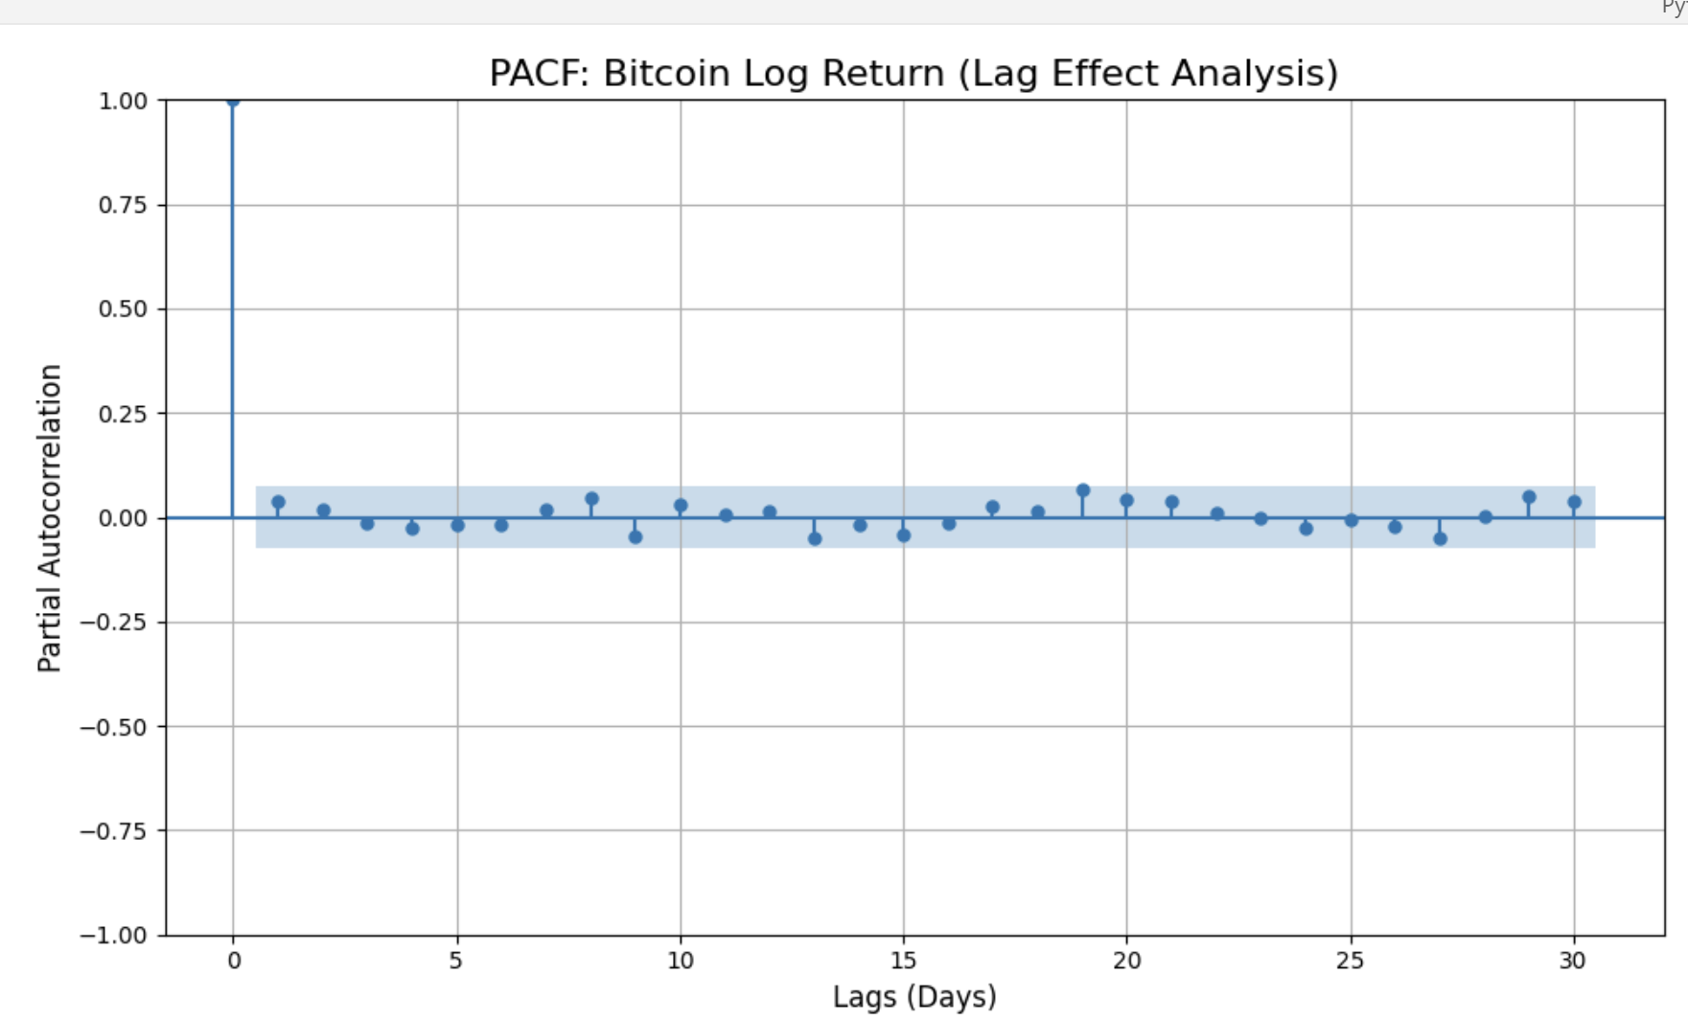
PACF: Bitcoin Log Return
Insights
Assess the Lag Effect of Past Log Return on Future Returns
Past log returns do not have a significant direct impact on current log returns beyond the immediate correlation with the present value (lag 0).
Previous days' log returns do not exhibit any meaningful lag effect on the current day's log return.
Notes:
Log returns show no significant lagged impact beyond Lag 0, which means the current day’s return is primarily independent of previous days’ returns. This points to the high randomness in Bitcoin’s daily returns, which we need to account for in our predictive models.
Together, these PACF analysis inform us which lagged variables are most relevant when building models for prediction.

Slide 23
03
Predictive
Modelling
Data + Model

Slide 24
Data Cleaning & Feature Engineering
Merge Datasets
Missing Value
Scaling
Target Variable and Features
Target - Log Return
Features - Trading Signals
Logarithmic Return =Ln(Close​)−Ln(Prev Close​)
Time Additive Continuous Compounding
Close Price: Bitcoin, Rates, Gold, Spy, VIX
Volatility = Ln(Ht) - Ln(Lt)
Alizadeh, Brandt and Diebold, 1999; Gallant, Hsu and Tauchen, 1999
Bollinger Band: rolling mean & std, upper & lower bound
Relative Strength Index(RSI): price delta, loss & gain MA
MACD: difference between 2 EMAs
Moving Averages: for close price
Lags: lag n, n = 1, … n
Notes:
So one of such attempts is lagged analysis. So the question we're really trying to answer here is how much influence does self-past value have on current values. Take the Bitcoin price or volatility today, to what extent does it impact the price or volatility tomorrow, the day after tomorrow, or 30 days after? We're trying to use lag analysis to determine the most relevant time frame where the lag impact takes place. And the proxy we're using is called PACF, partial autocorrelation function. It is a measure of correlation specifically designed for time series, focuses on how much influence past values have on current value, and it's called partial because it isolates a direct relationship between time lag variables. Filtering out intermediate correlations so we can see the direct impact across time frame.

Slide 25
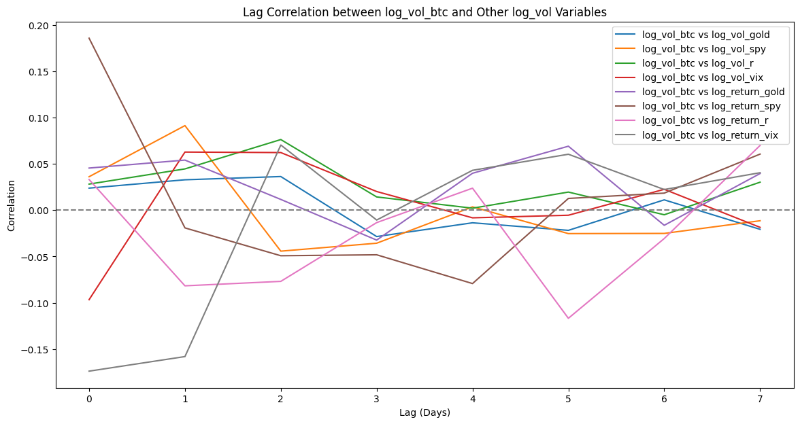
Data Cleaning & Feature Engineering
How do we get the lag external variables

Slide 26
Modelling Overview
Linear Regression
Time Series Analysis
Feature Selection
Modelling Method
Input Variables
Exogenous variables lag
Exogenous variables lag Technical Variables
Exogenous variables lag Technical Variables Moving Average
Exogenous variables lag Technical Variables Moving Average Close price lag
Matrics
P-values
R Squared
MSE
MAE
Use
SelectFromModel
to select the most important features based on the coefficients of a trained model
Ignore the time effects
Auto regression

Slide 27
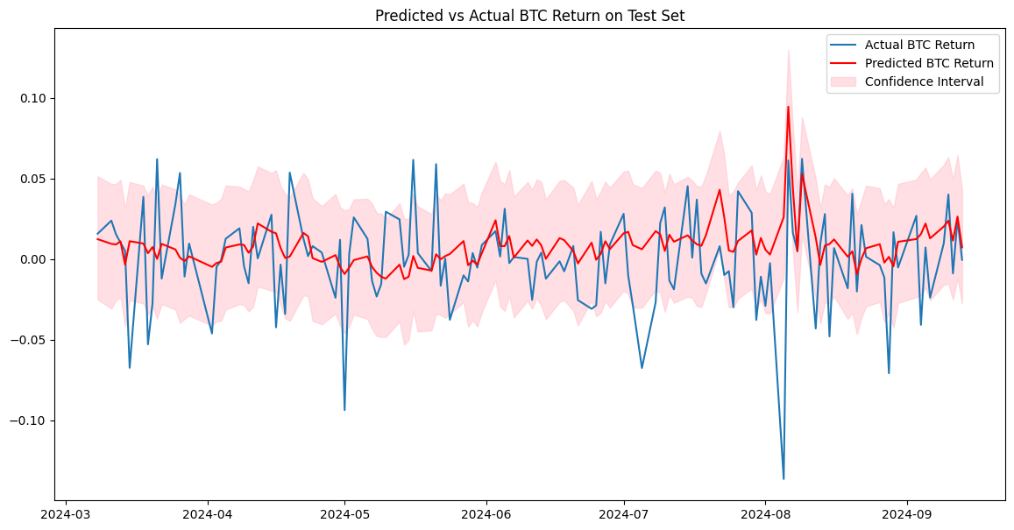
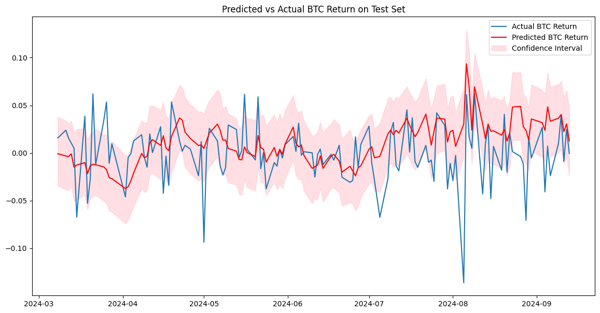
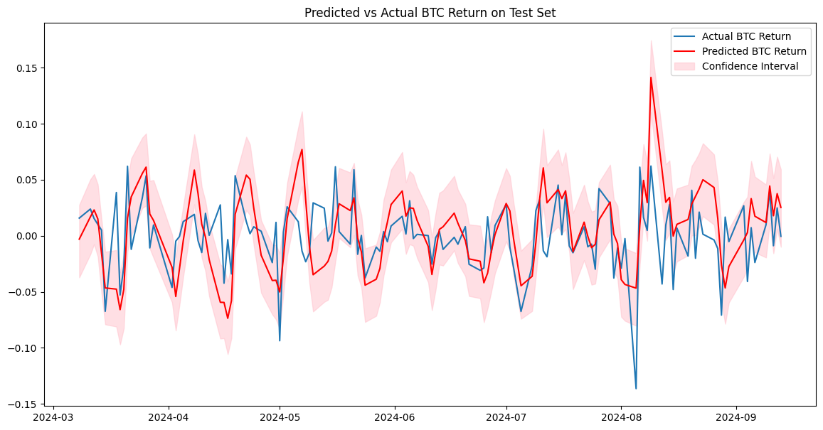
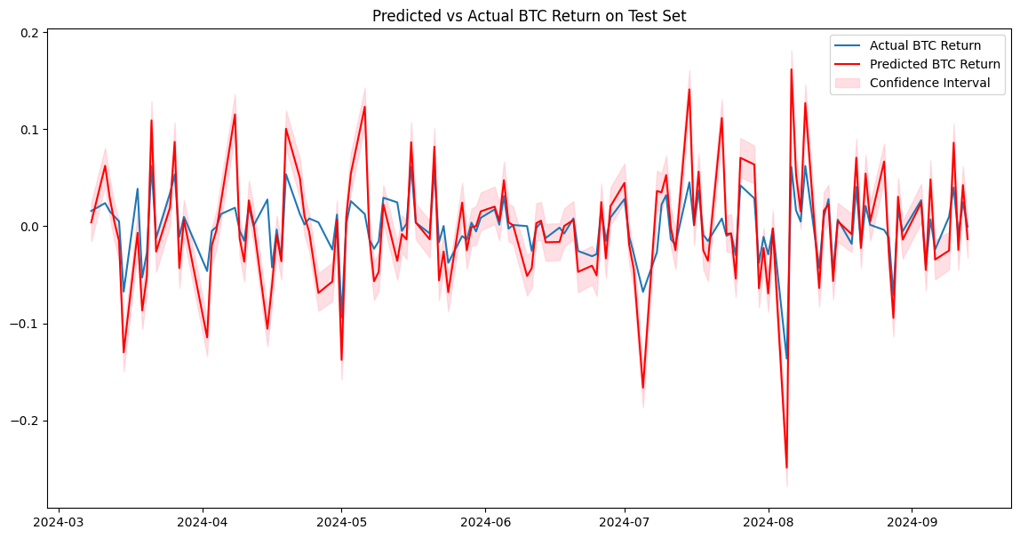
Modelling Time Series
When increase more features, the time series model became worse
Exogenous variables lag
Exogenous variables lag + Technical
①
②
Lowest MSE
Failed to capture the volatility
Exogenous variables lag + Technical
MA
Exogenous variables lag + Technical
MA + Close Price Lag
③
④
Highest MSE
Overfit to the volatility

Slide 28
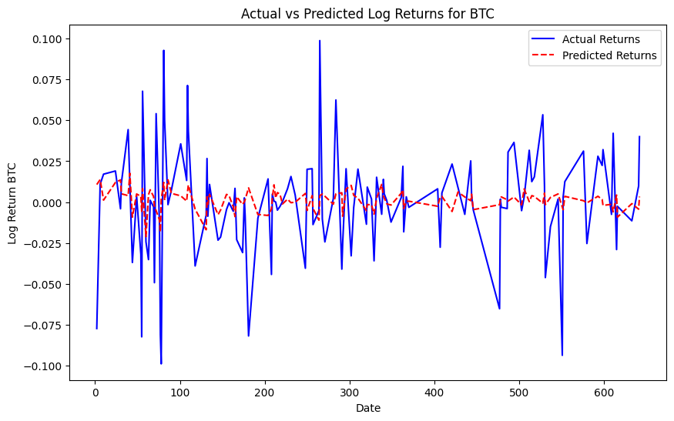
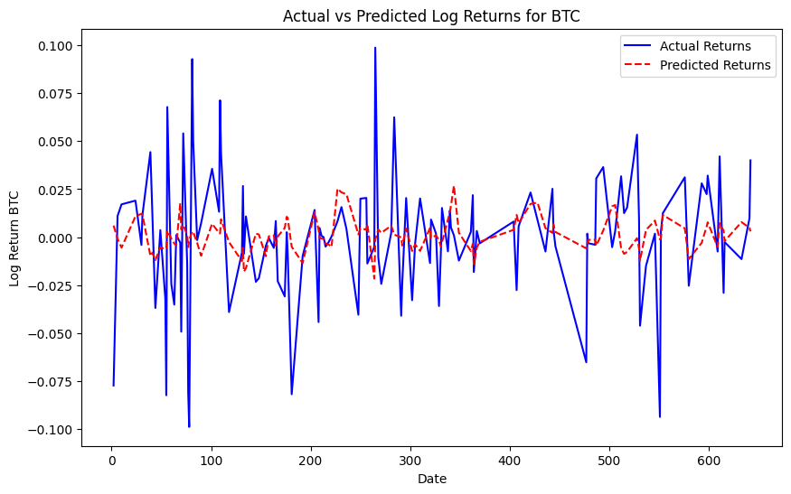
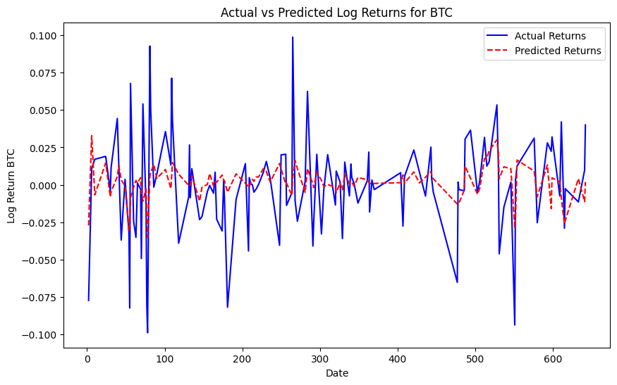
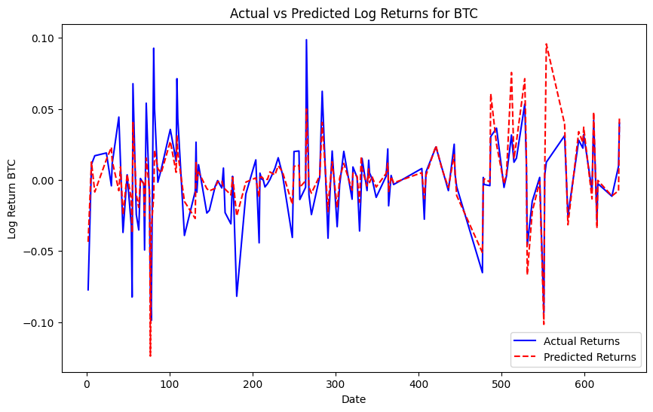
Modelling Linear Regression
When increase more feature, the linear model became better
Exogenous variables lag
Exogenous variables lag + Technical
①
②
Exogenous variables lag + Technical
MA + Close Price Lag
Exogenous variables lag + Technical
MA
Highest R Squared
Capture the volatility with significant
p-value
③
④

Slide 29
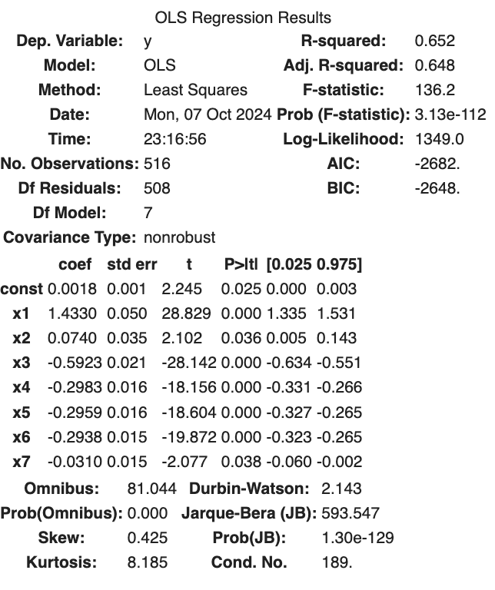
Modelling Final Model
Linear Regression Model with Exogenous variables lag + Technical MA + Close Price Lag
Exogenous variables lag
X1:log_return_gold_lag_5
X2:log_return_spy_lag_0
X3: macd_signal
X4: BTC Close MA30
X5: BTC Close lag7
X6: BTC Close lag14
X7: BTC Close lag28
Model Explanation
Why gold, SPY, and Bitcoin rise together? Strong market confidence during this period
Why past BTC value decrease the return? After past price increases, market dynamics like profit-taking, mean reversion, and market saturation can lead to lower returns today

Slide 30
Insights
Why Linear Regression is better dealing with daily return of BTC
Why adding MA and Lag price increase the R Squared in linear regression
BTC returns are primarily driven by external variables (regressors) rather than their own past return
For investor decision making, historical close price has higher priority than return.
Moving averages capture trends and momentum, providing useful information about market behavior.
Lagged prices allow the model to capture patterns like momentum or mean reversion, which are common in financial time series.

Slide 31
Future Steps
As a Portfolio Manager
Backtesting the Model
Evaluate the model's performance on historical data, cumulative returns, Sharpe ratio, and max drawdown.
Scenario & Stress Testing
model's robustness under extreme market scenarios
Position Sizing & Risk Management
Define position sizing strategies and risk management mechanisms
(e.g., stop-losses, take-profits).
Transaction Costs & Slippage Analysis
Portfolio Construction
Build diversified portfolio
Model Updates & Retraining

Slide 32
Thanks for
Listening
Q&A Session

